Slide 1
SUIT
IETF 104 Hackathon Report

Slide 2



Software Update for IoT (suit)
Architecture &metadata for IoT firmware updates (also on small microcontrollers!)
Hands-on work on latest metadata draft draft-moran-suit-manifest-04
IoT Software Maintainer
network
IoT Device

Slide 3
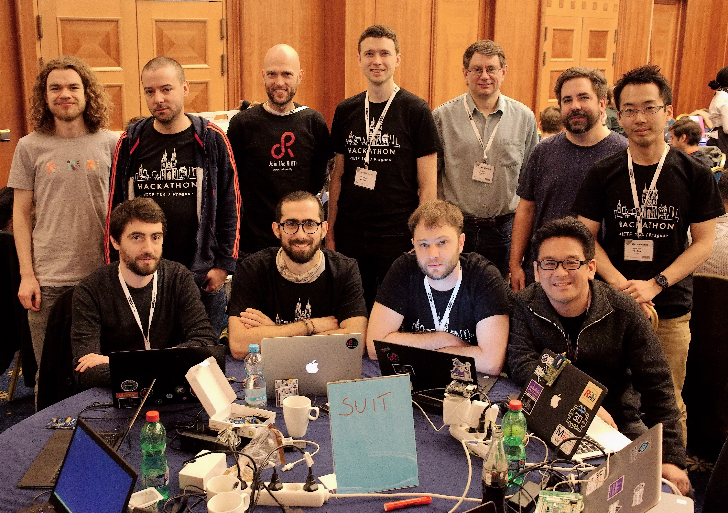
SUIT Hackathon Team!
Brendan Moran
Koen Zandberg
Emmanuel Baccelli
Yuichi Takita
Tadahiko Ito
Kaspar Schleiser
Alexandre Abadie
Francisco Molina
Daniel Petrie
Daniel Petry
Dave Thaler

Slide 4
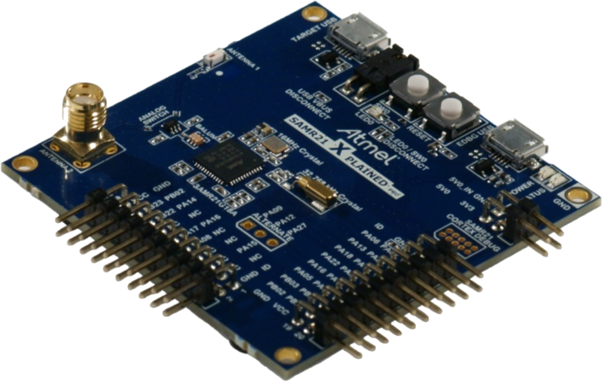
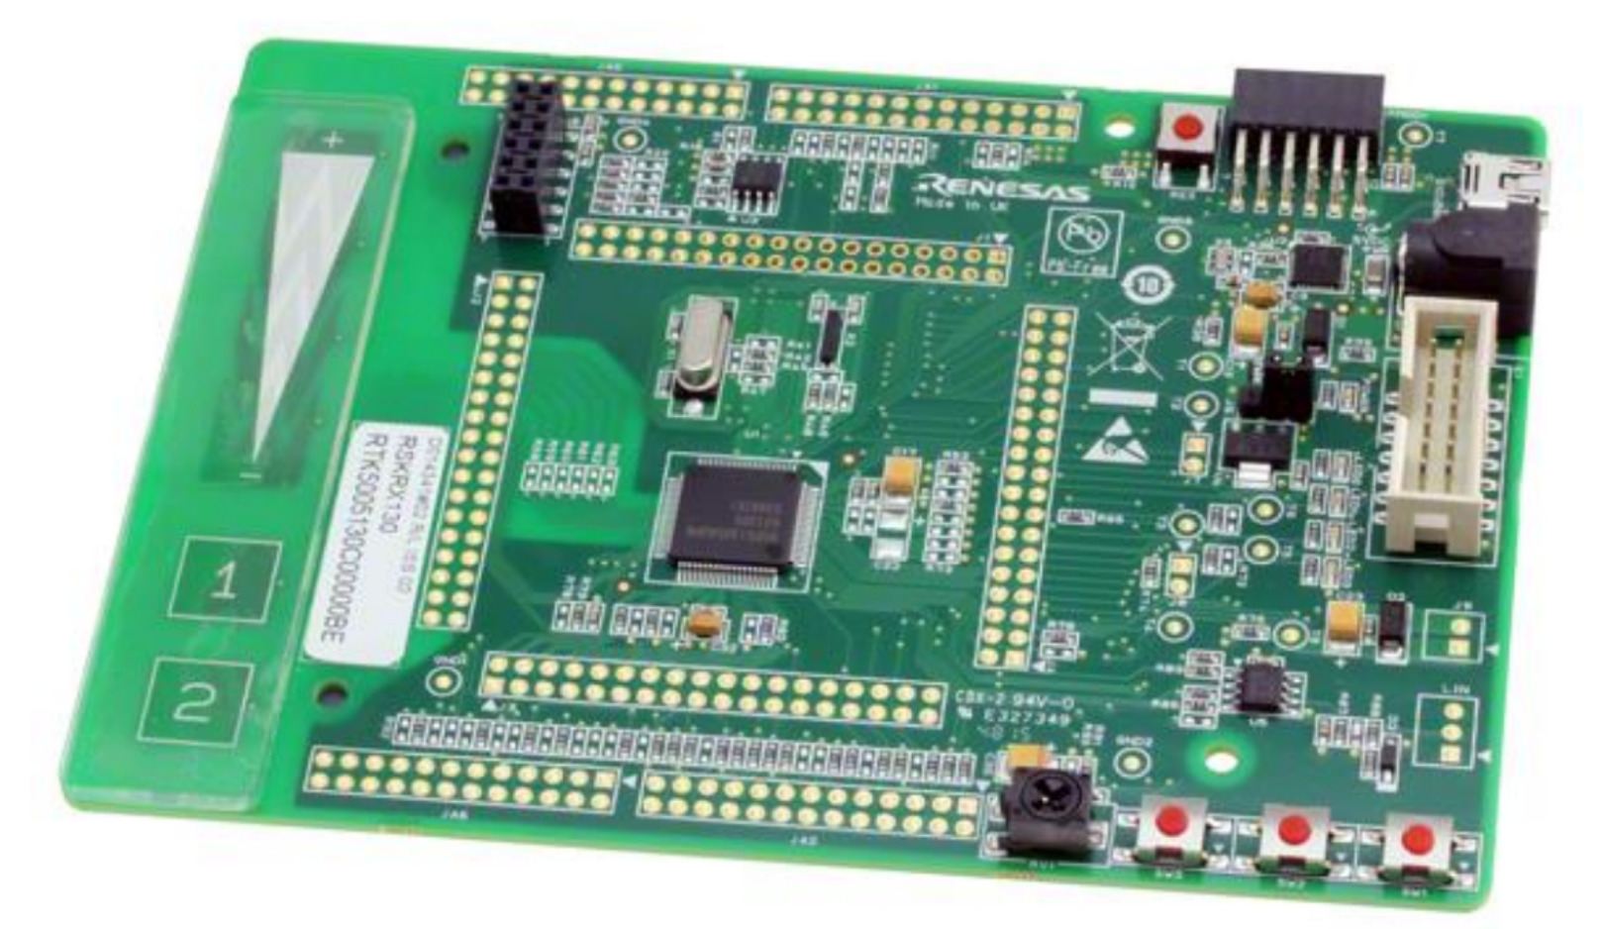

What happened at the Hackathon?
Manifest generators!
2 independent implementations (ARM, Renesas)
Manifest parsers!
3 independent implementations (Inria, ARM, Renesas)
2 of which running on micro-controllers
Interoperability!
Manifest generator (ARM) <=> parsers from Inria & Renesas
Full workflow demonstrated!
Based on RIOT
Microchip SAMR21
Cortex-M0+
32kB RAM, 256kB ROM
Renesas Starter Kit
RX231
64kB RAM

Slide 5
More info?
IETF SUIT Working Group:
https://datatracker.ietf.org/wg/suit/about/
Manifest draft used:
https://tools.ietf.org/html/draft-moran-suit-manifest-04
Etherpad from Hackathon:
https://etherpad.net/P/ietf104-suit-hackathon

